Slide 1

$′Background estimation of MonoHiggs in b\overline{b} final state using 2018 data of the CMS detector at the LHC, CERN$’

Slide 2
Outline

Slide 3
Outline
Recap
Top(e) boosted CR
Event Selections
Object Selections
Results
Kinematic plots
Conclusion

Slide 4
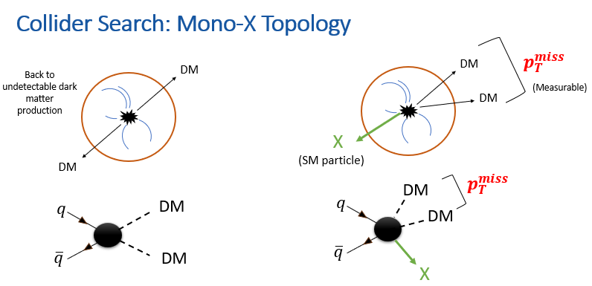

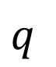

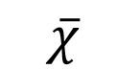
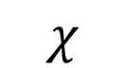
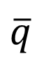
Recap 1
$p_{T}^{miss}$
$$χ$$
$$q$$
$$\overline{χ}$$
$$\overline{q}$$
h
Mono Higgs Searches
No Initial State Radiation
More closely connected to DM production
Signal Signature has a high MET trail which helps to separate the signal from background.
My focus H(125)->bb
H(125)->bb branching ratio is ~ 57%
Final state: $H\left(\overline{b}b\right)+large p_{T}^{miss}$

Slide 5
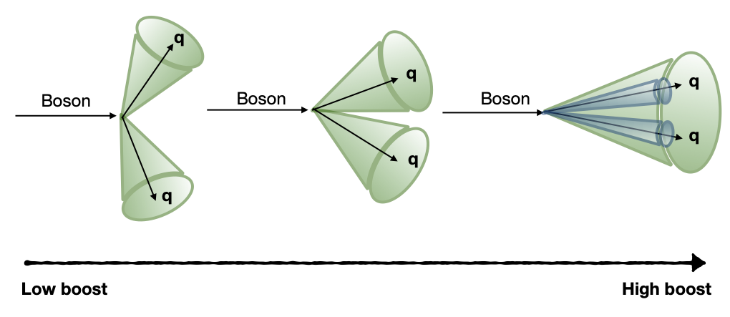
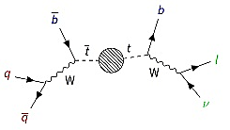
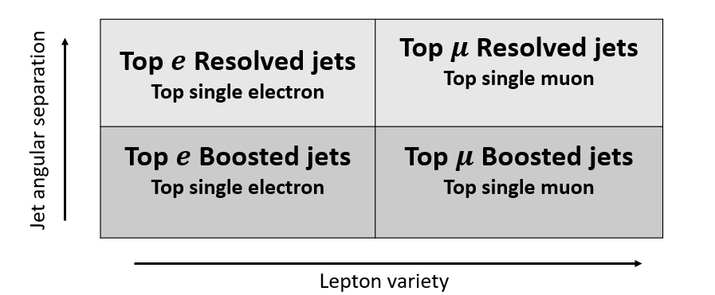
Recap 2
Resolved
Boosted
Backgrounds
Top quark pair production
Single top production
W+jets
Z(νν)+jets
Drell-Yan(DY)+jets
Other minor backgrounds
Ak8 jets
Ak4 jets

Slide 6




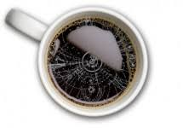








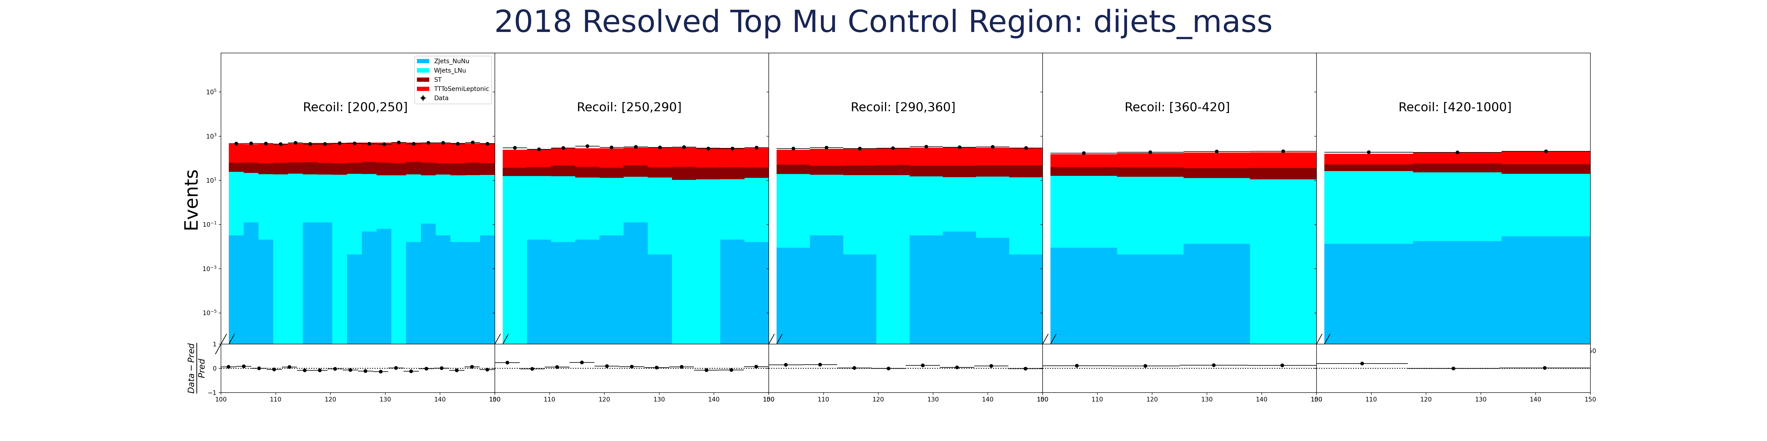
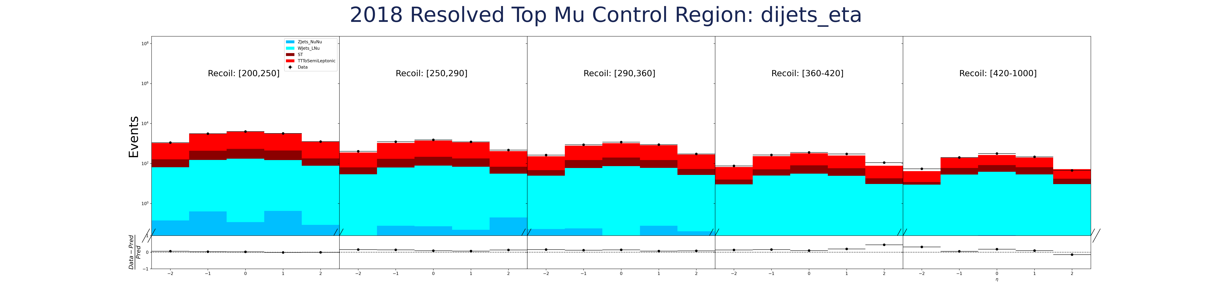
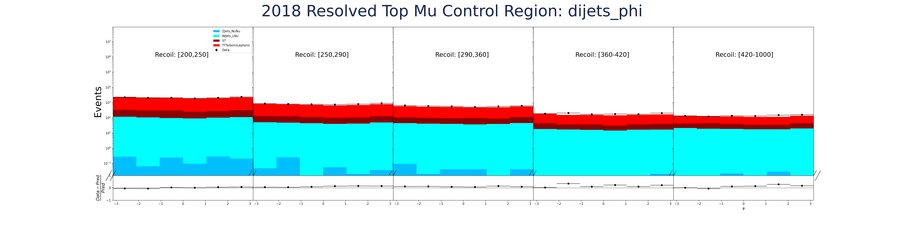
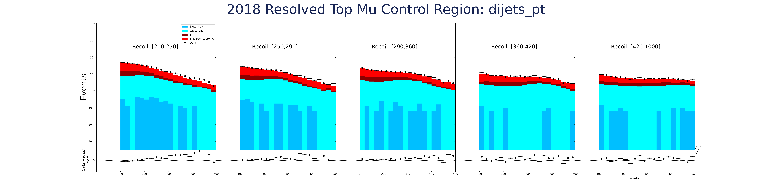

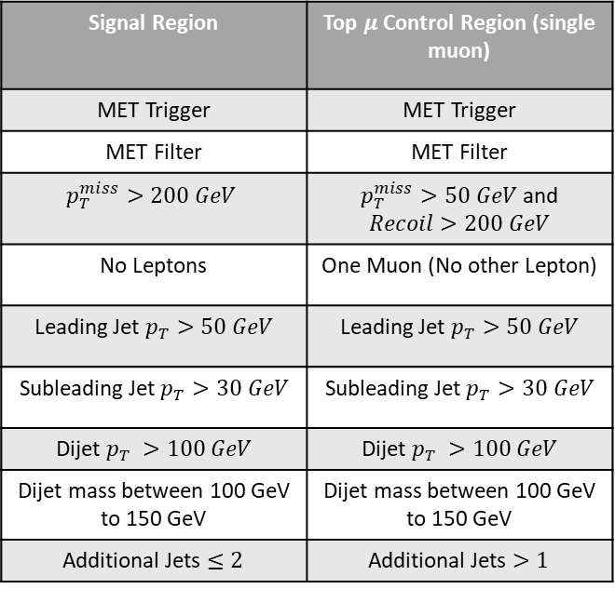
Recap 3
Signal Region | Top $μ$Control Region (single muon)
MET Trigger | MET Trigger
MET Filter | MET Filter
$$p_{T}^{miss}>200 GeV$$ | $p_{T}^{miss}>50 GeV$ and $Recoil>200 GeV$
No Leptons | One Muon (No other Lepton)
Leading Jet $p_{T}>50 GeV$ | Leading Jet $p_{T}>50 GeV$
Subleading Jet $p_{T}>30 GeV$ | Subleading Jet $p_{T}>30 GeV$
Dijet $p_{T} >100 GeV$ | Dijet $p_{T} >100 GeV$
Dijet mass between 100 GeV to 150 GeV | Dijet mass between 100 GeV to 150 GeV
Additional Jets $≤2$ | Additional Jets $>1$
COFFEA (Columnar Object Framework For Effective Analysis) Framework

Slide 7

Top(e) Boosted Control Region
Estimated the Top Muon Resolved CR (without corrections) last time.
Estimated the Top Electron Boosted CR (with corrections) this time

Slide 8
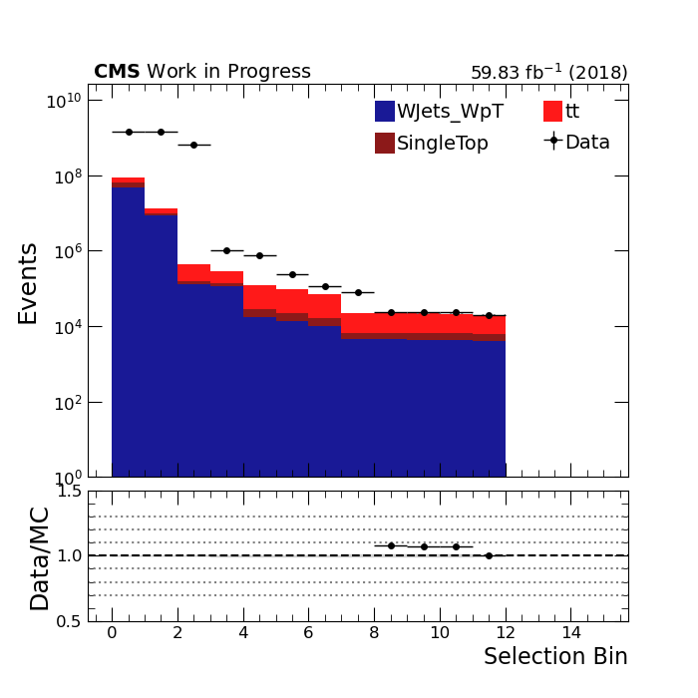
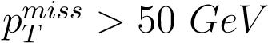
Event Selections
Dataset Name | Events selected for
/EGamma/NANOAOD/Run2018[A-D]/UL2018_MiniAODv2_NanoAODv9-v1/* | Single-Electron CR 2018UL
~ 285 million events
Selection Bin | Event Selection | Description
0 | No cuts | Raw
1 | MET − Filters | To remove MET noise
2 | Electron Trigger | Choose Single-Electron events
3 | N(FatJet) = 1 | One ak8 Jet only
4 | N(IsoAddJet) ≤ 2 | Two additional Jets
5 | N(IsoLoosebTagJet) = 1 | One loose b-Tagged Jet
6 | N(e) = 1 & N(µ) = 0 | One Electron and no Muon
7 |  | To remove QCD backgrounds
8 | Recoil > 250 GeV | Final state requirement for boosted category
9 | N(τ) = 0 | Tau veto
10 | N(γ) = 0 | Photon veto
11 | HEM veto | Removing HEM affected events (detector issue in 2018)
Fig: Preliminary cut-flow without corrections

Slide 9
Event Selections
Trigger turn-on pt
Selects events with at least one Tight electron(90% signal efficiency)
Trigger
Electron Trigger: HLT_Ele32_WPTight_Gsf used for the analysis.
This adds the advantage of reducing the analysis’s required computing time.
To account for different efficiencies of algorithms in Data events and Monte-Carlo simulated events, appropriate scale factors are applied on histograms produced from MC events. Some of these scale factors(SFs) and corrections are Electron-Trigger SF, b-Tagging SF, PileUp reweight SF, Jet Energy Calibration and Jet Energy Resolution, L1 prefiring and Top reweighting [36]. Each of these also carry an uncertainty with them.
Corrections and Scale factors

Slide 10
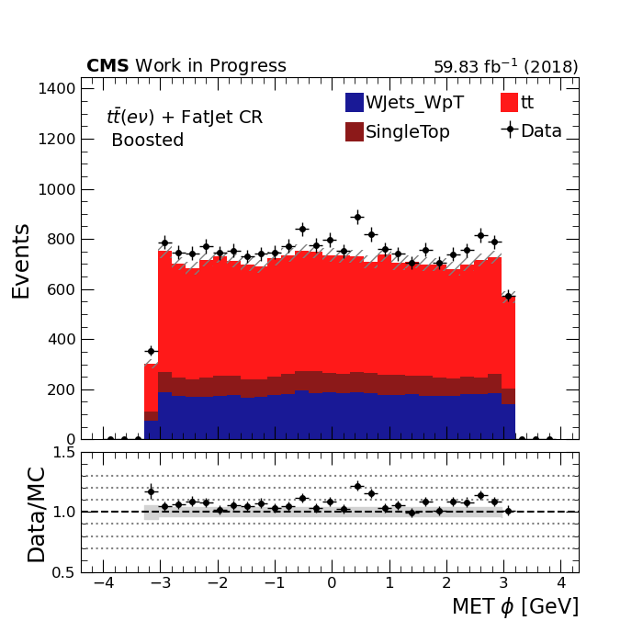
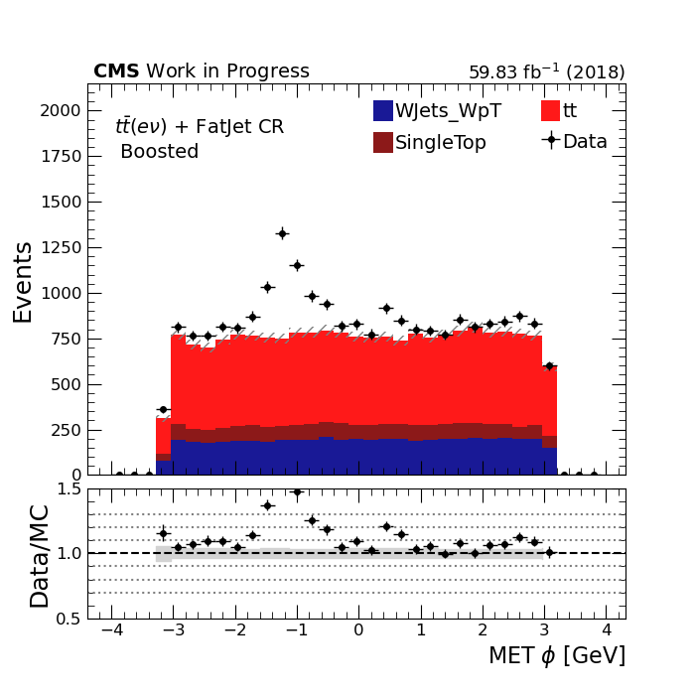
Event Selections
HEM Veto
In 2018, power supply of two HCAL modules in range η : -3.0 to -1.3 and ϕ : -1.57 to-0.87 was compromised. Therefore, in this analysis we remove any event which has at least one jet or fatjet lying in this range.
Excess in MET due to HEM issue
Fixed

Slide 11
Object Selections: Fatjets (ak8 jets)
Fatjets (ak8 jets) were selected using a series of selections shown in the table.
Since Fatjets contain two overlapping ak4 jets, their mass should be close to the Higgs mass. This is asserted by choosing the mass range of fatjets between 70 GeV to 150 GeV.
Selection | Description
p_{T} > 30 GeV | To remove low pt jet noise
|η| < 2.5 | Extent of calorimeters
jetID ≥ 2 | Tight ak8jets
70 GeV < M_{softdrop} < 150 GeV | Mass around Higgs mass
∆R(Fatjet,e) > 0.4 & ∆R(Fatjet,µ) > 0.4 | Jets isolated from Electrons and Muons

Slide 12
Object Selections: Additional Jets (ak4 jets)
Selection | Description
p_{T} > 30 GeV | To remove low pt jet noise
|η| < 2.5 | Extent of calorimeters
jetID ≥ 2 | Tight ak4jets
∆R(jet,e) > 0.4 & ∆R(jet,µ) > 0.4 | Jets isolated from Electrons and Muons
Unlike Fatjets, there is no selection of the mass of jets.

Slide 13
Object Selections: Electrons
Selection | Description
p_{T} > 40 GeV | To be about the trigger’s turn on (32 GeV)
|η| < 2.5 | Extent of calorimeters
cutBased ≥ 4 | Tight Electrons
gapcuts | Remove Electrons from ECAL gap
Electrons are selected considering the threshold of the Electron trigger.
The trigger threshold, also known as trigger turn-on, is 32 GeV here. So the p_{t} cut is 40 GeV.

Slide 14
Object Selections: Muon , Tau and Photon
Selection | Description
p_{T} > 15 GeV | Remove low p_{T} noise
|η| < 2.4 | Extent of Muon chambers
isPFcand | Is a particle flow candidate
isTracker & isGlobal | Has signature in tracker and globally
looseId | Loose Muons
pfRelIso04 all < 0.25 | Relative isolation from other objects
Selection | Description
p_{T} > 20 GeV | Remove low p_{T} noise
|η| < 2.3 | Extent of calorimeters
idDecayModeOldDMs & decayMode= 5 or 6 | Veto “experimental 2-prong”
idDeepTau2017v2p1VSe ≥ 8 & idDeepTau2017v2p1VSmu ≥ 2 & idDeepTau2017v2p1VSjet ≥ 8 | Parameters for tau tagging algorithms
Muon selections in the analysis
Tau selections in the analysis
Selection | Description
p_{T} > 20 GeV | Remove low p_{T} noise
|η| < 2.5 | Extent of calorimeters
cutBased ≥ 1 | Loose Photons
Photon selections in the analysis

Slide 15
Results
After applying all the event selections, various analysis objects were selected following the object selections.
Relevant kinematic variables like p_{T}. η, ϕ and mass were plotted for Electrons, Fatjets, additional jets, MET and Recoil.
The various backgrounds were also scaled according to luminosity and the cross-sections of the relevant MC process.
A summary of the results is shown in the subsequent slides.

Slide 16
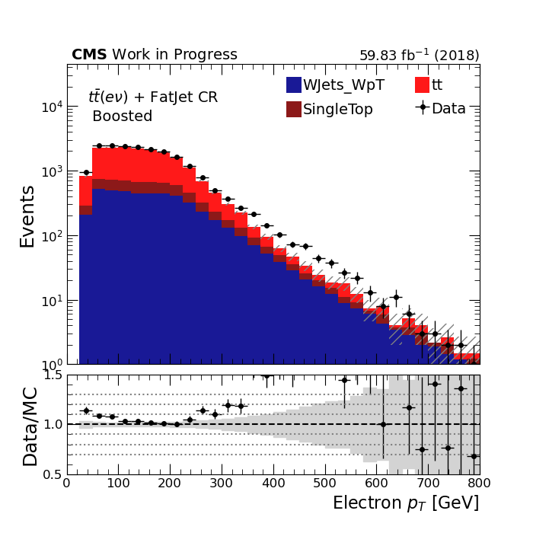
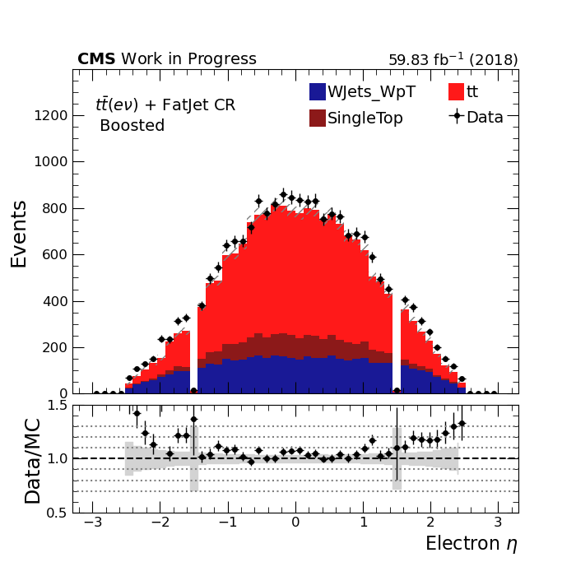
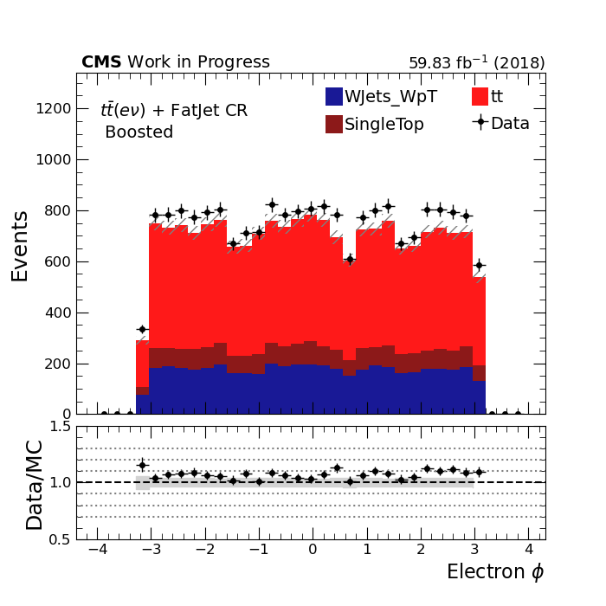
Kinematic Plots: Electron
Electrons are an important part of the Top(e) control region because they tag the process.
The plots show the expected shapes in the three kinematic variables.
The Y-axis is the number of events which pass the selection in the log scale. The X-axis denotes the kinematic variables.

Slide 17
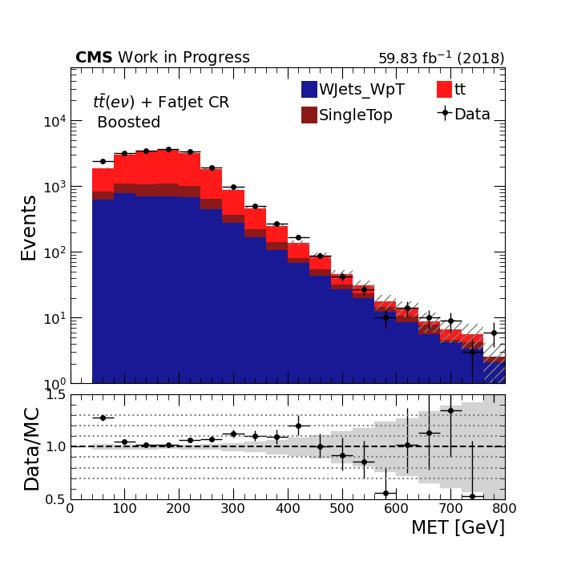
Kinematic Plots: Missing Transverse Energy(MET)
Another important parameter in the analysis is Missing Transverse Energy.
As expected, MET has smooth variation over the momentum ranges and is almost uniform across the ϕ direction

Slide 18
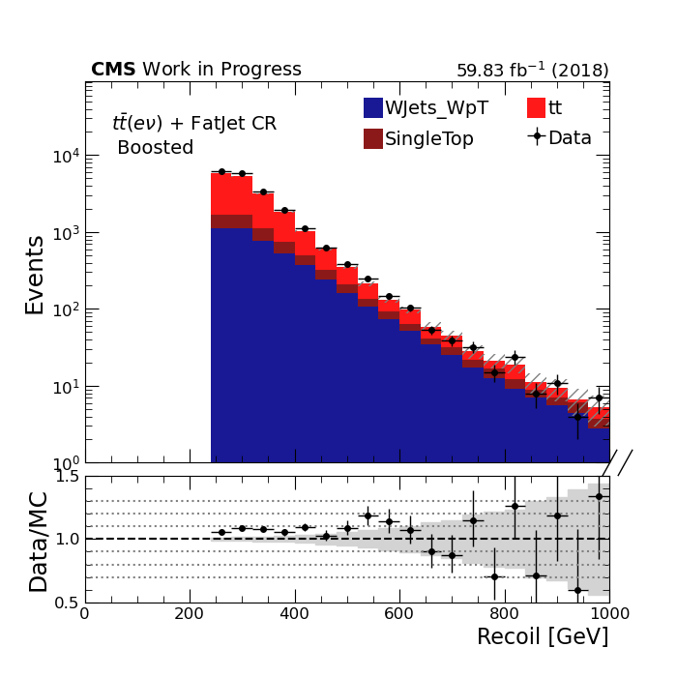
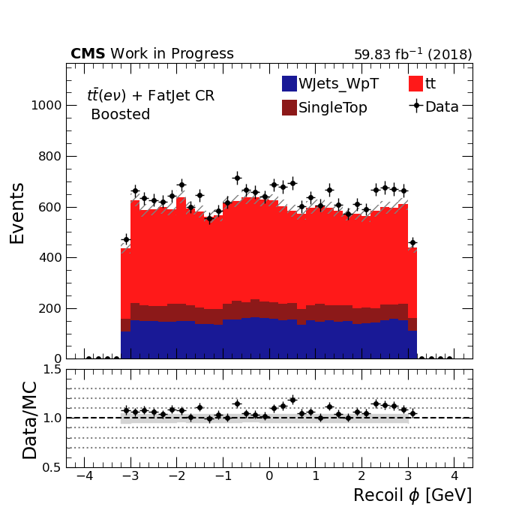
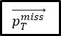
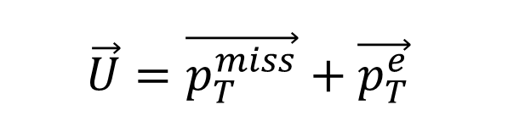
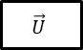
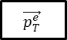
Kinematic Plots: Recoil
$$\vec{U}=\vec{p_{T}^{miss}}+\vec{p_{T}^{e}}$$
bjet
bjet
$$\vec{p_{T}^{e}}$$
$$\vec{p_{T}^{miss}}$$
$$\vec{U}$$
Similar to MET, Recoil shows a smooth variation over the momentum ranges and is almost uniform across the ϕ direction.
The Recoil > 250 GeV cut is clearly visible in the Recoil vs Events plot.

Slide 19
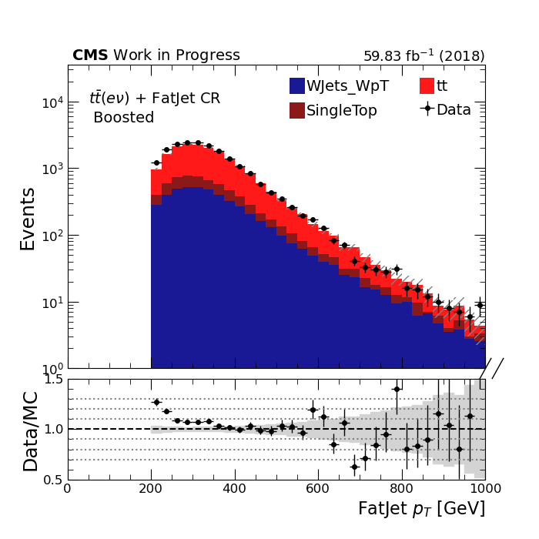
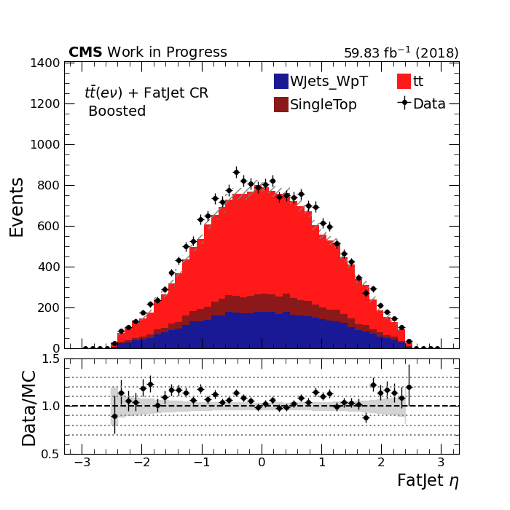
Kinematic Plots: Fatjets (ak8 jets)

Slide 20
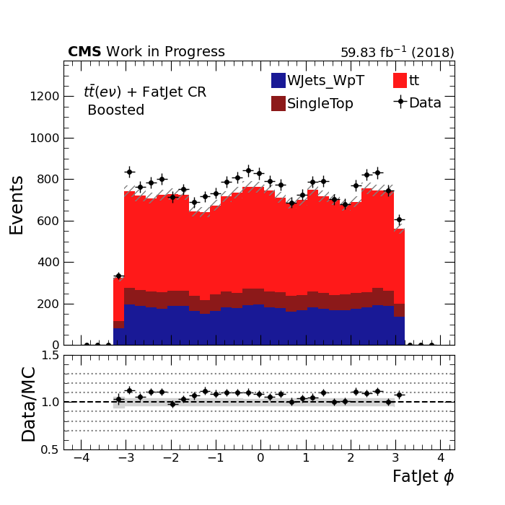
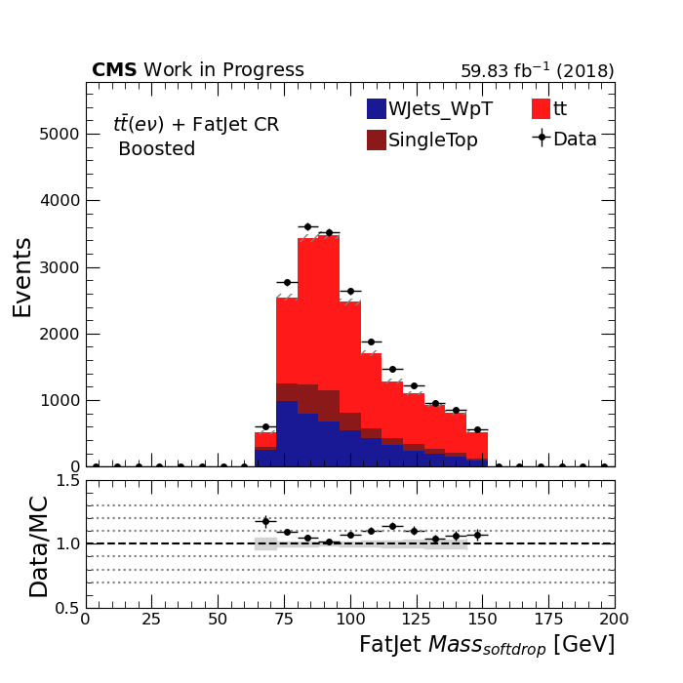
Kinematic Plots: Fatjets (ak8 jets)
Fatjet is a probe of the Higgs boson in the signal final state. The plots show a mass peak below 125 GeV (Higgs boson mass). So, it is safe to say that the majority of contributions from the top background stay below the Higgs mass.
The mass shown in the plots is the soft-drop mass, which is the mass of the jet obtained from a soft-drop clustering algorithm.

Slide 21
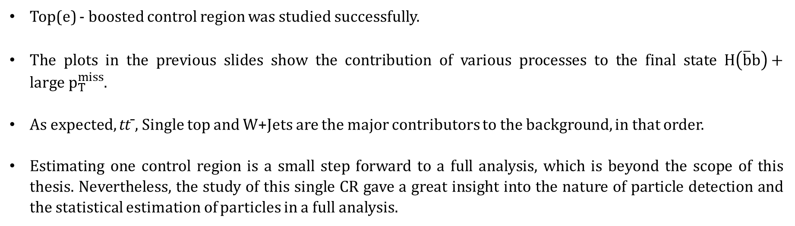
Conclusion
Top(e) - boosted control region was studied successfully.
The plots in the previous slides show the contribution of various processes to the final state $H\left(\overline{b}b\right)+large p_{T}^{miss}$.
As expected, tt¯, Single top and W+Jets are the major contributors to the background, in that order.
Estimating one control region is a small step forward to a full analysis, which is beyond the scope of this thesis. Nevertheless, the study of this single CR gave a great insight into the nature of particle detection and the statistical estimation of particles in a full analysis.

Slide 22
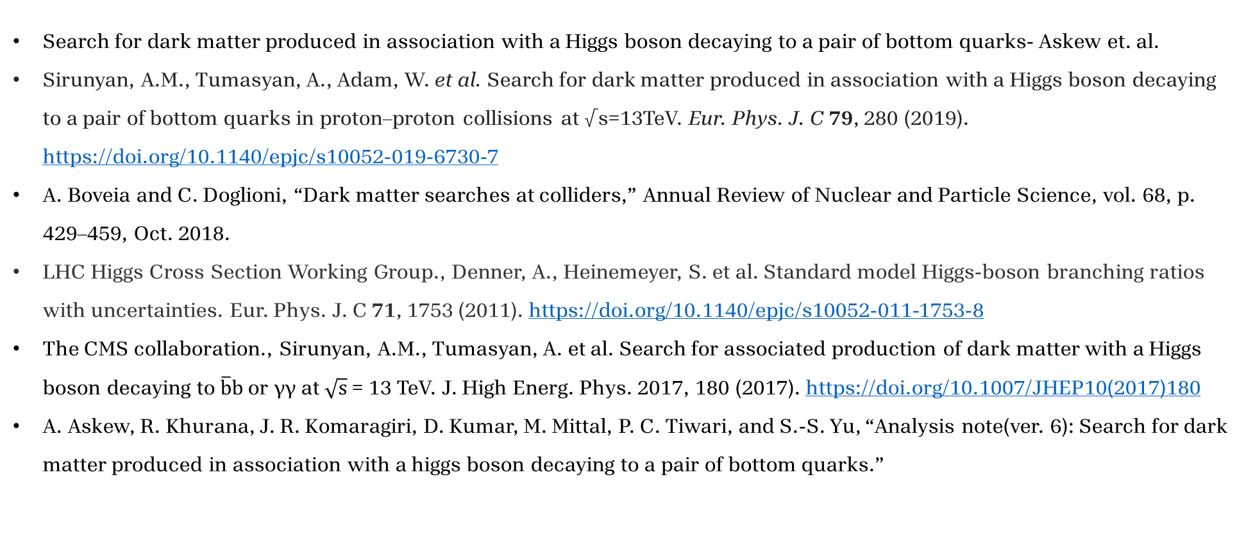
References i
Search for dark matter produced in association with a Higgs boson decaying to a pair of bottom quarks- Askew et. al.
Sirunyan, A.M., Tumasyan, A., Adam, W. et al. Search for dark matter produced in association with a Higgs boson decaying to a pair of bottom quarks in proton–proton collisions at √s=13TeV. Eur. Phys. J. C 79, 280 (2019). https://doi.org/10.1140/epjc/s10052-019-6730-7
A. Boveia and C. Doglioni, “Dark matter searches at colliders,” Annual Review of Nuclear and Particle Science, vol. 68, p. 429–459, Oct. 2018.
LHC Higgs Cross Section Working Group., Denner, A., Heinemeyer, S. et al. Standard model Higgs-boson branching ratios with uncertainties. Eur. Phys. J. C 71, 1753 (2011). https://doi.org/10.1140/epjc/s10052-011-1753-8
The CMS collaboration., Sirunyan, A.M., Tumasyan, A. et al. Search for associated production of dark matter with a Higgs boson decaying to $\overline{b}b$ or γγ at $\sqrt{s}$ = 13 TeV. J. High Energ. Phys. 2017, 180 (2017). https://doi.org/10.1007/JHEP10(2017)180
A. Askew, R. Khurana, J. R. Komaragiri, D. Kumar, M. Mittal, P. C. Tiwari, and S.-S. Yu, “Analysis note(ver. 6): Search for dark matter produced in association with a higgs boson decaying to a pair of bottom quarks.”

Slide 23
References ii
J. Pivarski, P. Das, C. Burr, D. Smirnov, M. Feickert, T. Gal, L. Kreczko, N. Smith, N. Biederbeck, O. Shadura, M. Proffitt, benkrikler, H. Dembinski, H. Schreiner, J. Rembser, M. R., C. Gu, J. R¨ubenach, M. Peresano, and R. Turra, “scikit-hep/uproot: 3.12.0,” July 2020
J. Pivarski, C. Escott, N. Smith, M. Hedges, M. Proffitt, C. Escott, J. Nandi, J. Rembser, bfis, benkrikler, L. Gray, D. Davis, H. Schreiner, Nollde, P. Fackeldey, and P. Das, “scikit-hep/awkward-array: 0.13.0,” July 2020.
G. Van Rossum and F. L. Drake, Python 3 Reference Manual. Scotts Valley, CA: CreateSpace, 2009.
L. Gray, N. Smith, A. Novak, P. Fackeldey, B. Tovar, Y.-M. Chen, G. Watts, and I. Krommydas, “coffea,” May 2024.
M. Rocklin, “Dask: Parallel computation with blocked algorithms and task scheduling,” in Proceedings of the 14th python in science conference, no. 130-136, Citeseer, 2015.
“CMS-T2 Resources — University of Wisconsin - 2013;Madison — hep.wisc.edu.” https://www.hep.wisc.edu/cms/comp/resource.html. [Accessed 18-05-2024].
A. Novak, H. Schreiner, and M. Feickert, “mplhep,” Sept. 2023.

Slide 24
References iii
J. D. Hunter, “Matplotlib: A 2d graphics environment,” Computing in Science & Engineering, vol. 9, no. 3, pp. 90–95, 2007.
JanLukasSpah, “Cutbasedelectronidentificationrun2.” https://twiki.cern.ch/twiki/bin/view/CMS/CutBasedElectronIdentificationRun2#Offline_selection_ criteria_for_V, 2023. [Accessed 19-05-2024].
WonJun, “Swguidemuonselection.” https://twiki.cern.ch/twiki/bin/view/CMS/ SWGuideMuonSelection, 2024. [Accessed 19-05-2024].
DanielWinterbottom, “Tauidrecommendationforrun2.” https://twiki.cern.ch/twiki/bin/view/CMS/TauIDRecommendationForRun2, 2023. [Accessed 19-05-2024].
RezaGoldouzian, “Cutbasedphotonidentificationrun2.” https://twiki.cern.ch/twiki/bin/view/CMS/CutBasedPhotonIdentificationRun2, 2022. [Accessed 19-052024].

Slide 25
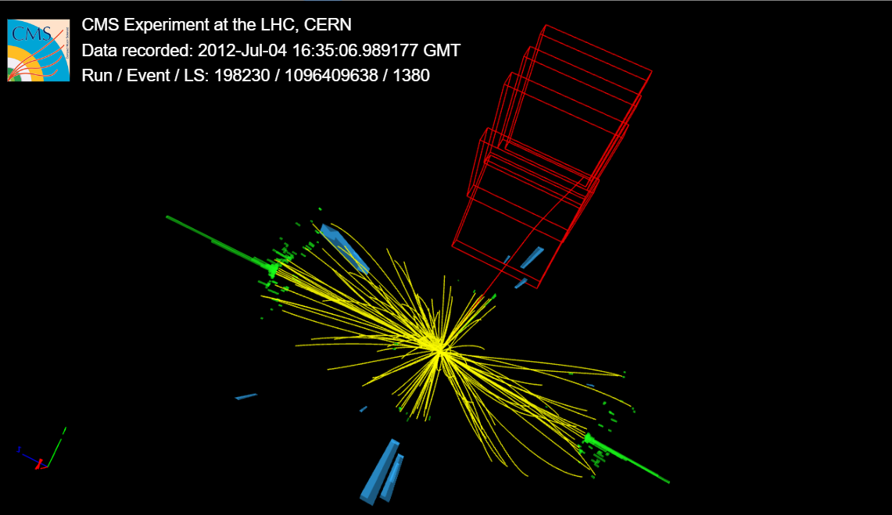
Thank you for your attention.
From iSpyGL , CERN open data

Slide 26
Backup Slides

Slide 27
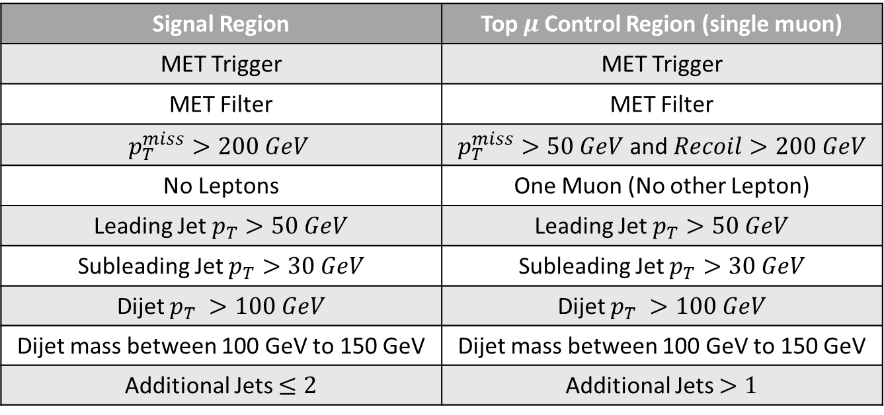
Selections in Signal Region and Control Region
Resolved
Signal Region | Top $μ$Control Region (single muon)
MET Trigger | MET Trigger
MET Filter | MET Filter
$$p_{T}^{miss}>200 GeV$$ | $p_{T}^{miss}>50 GeV$ and $Recoil>200 GeV$
No Leptons | One Muon (No other Lepton)
Leading Jet $p_{T}>50 GeV$ | Leading Jet $p_{T}>50 GeV$
Subleading Jet $p_{T}>30 GeV$ | Subleading Jet $p_{T}>30 GeV$
Dijet $p_{T} >100 GeV$ | Dijet $p_{T} >100 GeV$
Dijet mass between 100 GeV to 150 GeV | Dijet mass between 100 GeV to 150 GeV
Additional Jets $≤2$ | Additional Jets $>1$

Slide 28
Selections in Signal Region and Control Region
Resolved
Signal Region | Top $μ$Control Region (single muon)
MET Trigger | MET Trigger
MET Filter | MET Filter
$$p_{T}^{miss}>200 GeV$$ | $p_{T}^{miss}>50 GeV$ and $Recoil>200 GeV$
No Leptons | One Muon (No other Lepton)
Leading Jet $p_{T}>50 GeV$ | Leading Jet $p_{T}>50 GeV$
Subleading Jet $p_{T}>30 GeV$ | Subleading Jet $p_{T}>30 GeV$
Dijet $p_{T} >100 GeV$ | Dijet $p_{T} >100 GeV$
Dijet mass between 100 GeV to 150 GeV | Dijet mass between 100 GeV to 150 GeV
Additional Jets $≤2$ | Additional Jets $>1$
Same
Same
Different
Different
Same
Same
Same
Same
Different

Slide 29
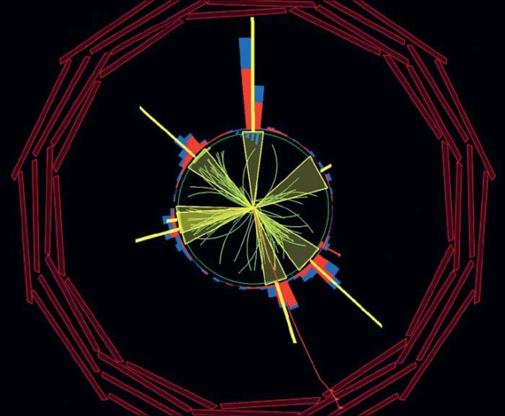
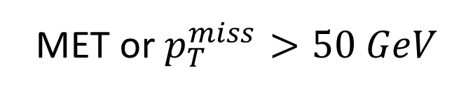
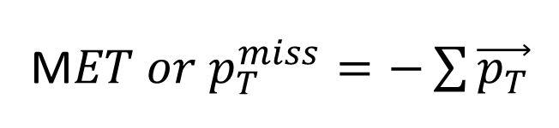
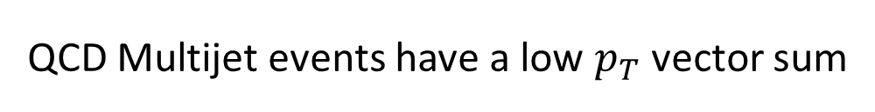
MET and Recoil criteria
MET cuts to avoid QCD
Recoil
M$ET or p_{T}^{miss}=−\sum{\vec{p_{T}}}$
MET or $p_{T}^{miss}>50 GeV$
https://cerncourier.com/a/a-watershed-the-emergence-of-qcd/
This cut ensures that we remove the majority of QCD events
QCD Multijet events have a low $p_{T}$ vector sum

Slide 30
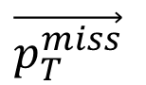
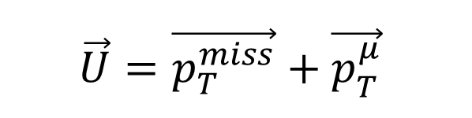
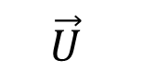
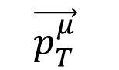
MET and Recoil criteria
bjet
bjet
MET cuts to avoid QCD
Recoil
$$\vec{U}=\vec{p_{T}^{miss}}+\vec{p_{T}^{μ}}$$
$$\vec{p_{T}^{μ}}$$
To mimic the effect of MET in the signal region, we define recoil which is the 2D vector sum of MET and transverse momentum of the chosen muon.
$$\vec{p_{T}^{miss}}$$
$$\vec{U}$$

Slide 31
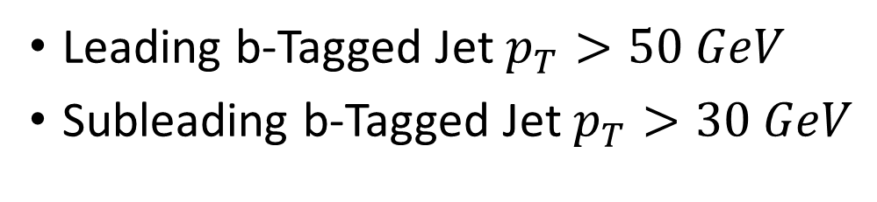
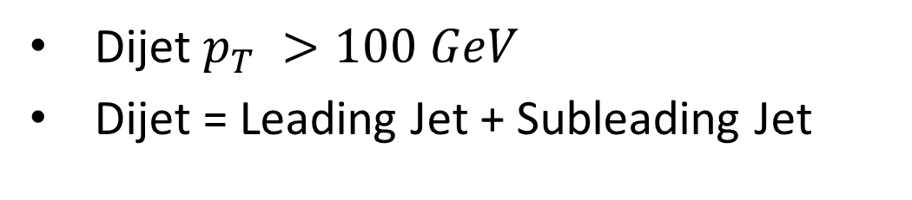
$p_{T}$ criteria and mass criteria
Leading b-Tagged Jet $p_{T}>50 GeV$
Subleading b-Tagged Jet $p_{T}>30 GeV$
To ensure a balanced contribution from both the jets (greater angle between Higgs line of travel and b jets)
Dijet $p_{T} >100 GeV$
Dijet = Leading Jet + Subleading Jet
To get a better probability that the dijet originates from a Higgs candidate with mass ~ 125 GeV
Dijet mass between 100 GeV to 150 GeV

Slide 32
My Efforts
Extensively used the COFFEA (Columnar Object Framework For Effective Analysis) Framework along with various other Python data analysis packages such as Dask, NumPy, SciPy, etc.
Preliminary development done locally in a server in lab, after which scaled to high throughput compute farms in University of Wisconsin, Madison, USA.

Slide 33
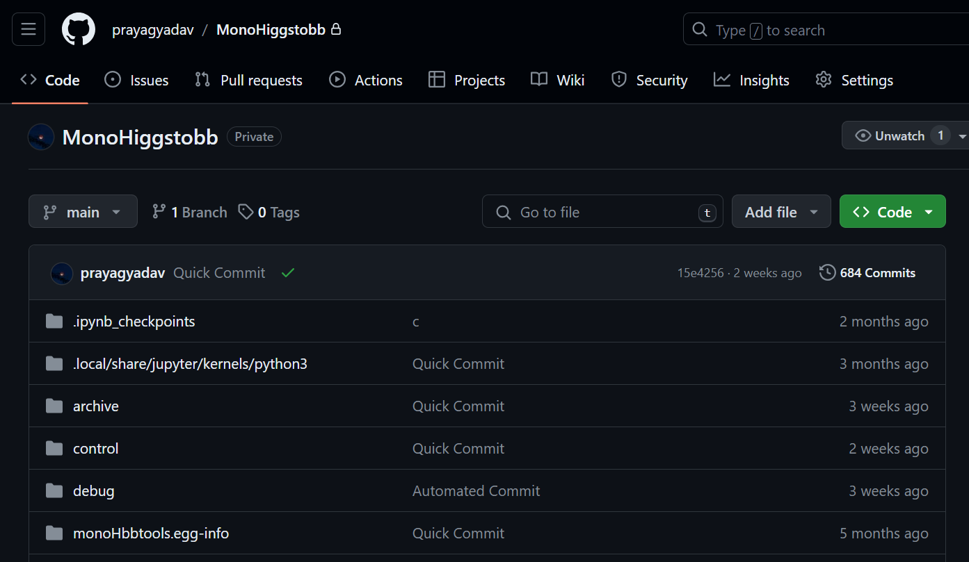
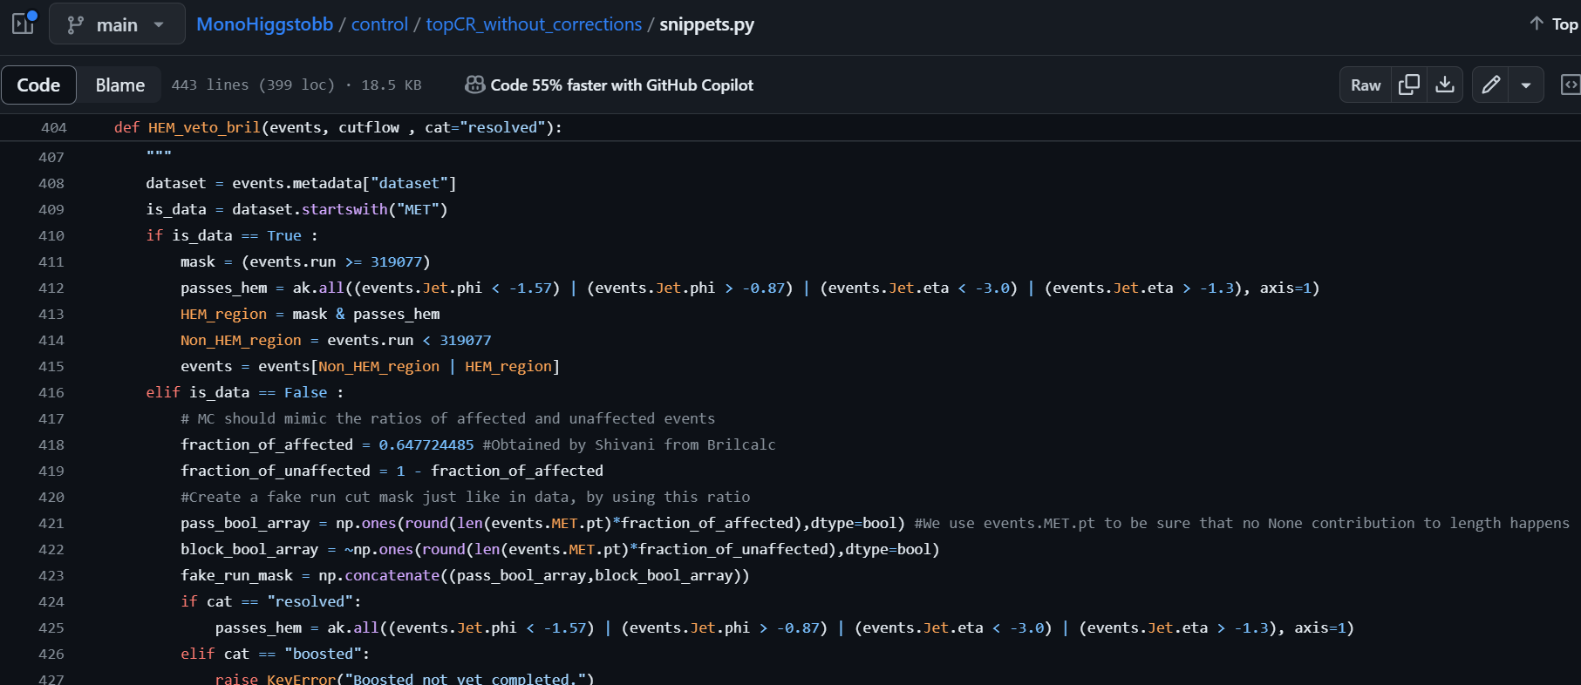
My Efforts
I have performed the Resolved Top Muon CR estimation for 2018.
More than 30,200 lines of code excluding blank lines written to get to the final optimized size of less than 3000 lines.
Almost 22 Terabytes of samples were processed multiple times.
Hours of development and processing in compute farms.

Slide 34

Top $μ$ Resolved jets Top single muon
Plots

Slide 35
Dijet Mass
Dijet Mass

Slide 36

Dijet $η$
Dijet $η$

Slide 37
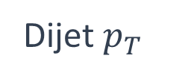
Dijet $p_{T}$
Dijet $p_{T}$

Slide 38

Dijet $φ$
Dijet $φ$

Slide 39


Missing transverse momentum $φ$ (MET-$φ$)
MET $φ$

Slide 40
Future Aspects
Next: do single electron CR estimation so that I can estimate top background in SR using both muon and electron CR.
Notes:
Old future aspects: Perform all or some part of control region studies with all the corrections, scaling, refactoring etc.
Perform signal region studies if time permits.

Slide 41
Quick Recap

Slide 42
Signal and Background
The backgrounds which mimic the dijet and missing transverse energy signal are :
Z(νν)+jets
W+jets
Drell-Yan(DY)+jets
Top quark pair production (tt)
Single top production(ST)
The production of the single top quark association with W boson (tW)
Diboson (WW, WZ, ZZ)
The associated production of a Higgs Boson with vector bosons (WH and ZH)
These backgrounds are estimated by using samples generated by Monte Carlo simulation of the reactions.
In addition to background, the 2HDMa(or closely related ZprimeBaryonic) model is also available as a simulated sample.

Slide 43
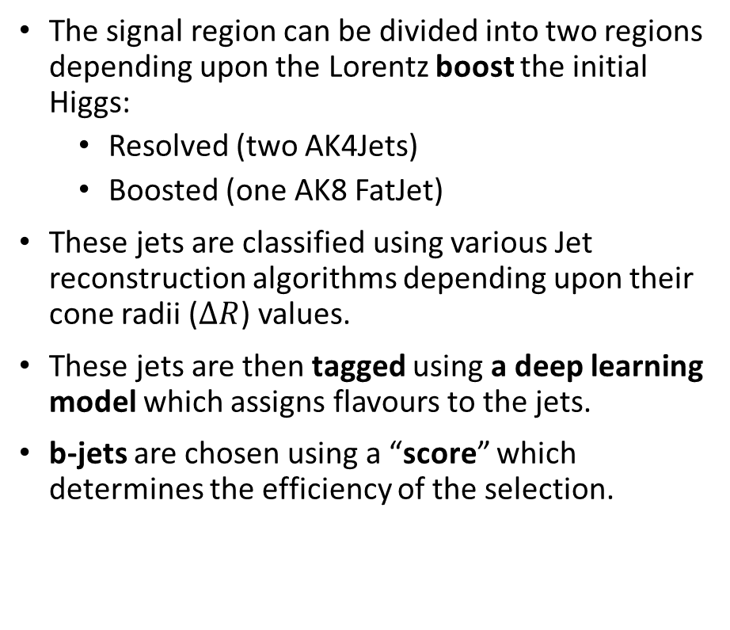
Signal and Background
Resolved
Boosted
The signal region can be divided into two regions depending upon the Lorentz boost the initial Higgs:
Resolved (two AK4Jets)
Boosted (one AK8 FatJet)
These jets are classified using various Jet reconstruction algorithms depending upon their cone radii ($ΔR$) values.
These jets are then tagged using a deep learning model which assigns flavours to the jets.
b-jets are chosen using a “score” which determines the efficiency of the selection.
Ak8 jets
Ak4 jets
Backgrounds
Z(νν)+jets
W+jets
Drell-Yan(DY)+jets
Top quark pair production (tt)
Single top production(ST)
The production of the single top quark association with W boson (tW)
Diboson (WW, WZ, ZZ)
The associated production of a Higgs Boson with vector bosons (WH and ZH)
Recap

Slide 44

Selections in Signal Region and Control Region
Orthogonality
Allow no leptons in SR.
Force one or two leptons in CR.
Keep in Mind
The final state
$$p_{T}^{miss}+2 bjets$$
The Basic Philosophy
Keep SR selections and CR selections similar but orthogonal to each other.

Slide 45

Selections in Signal Region and Control Region
Orthogonality
Allow no leptons in SR.
Force one or two leptons in CR.
The Basic Philosophy
Keep SR selections and CR selections similar but orthogonal to each other.
Keep in Mind
The final state
$$p_{T}^{miss}+2 bjets$$

Slide 46

Selections in Signal Region and Control Region
The Basic Philosophy
Keep SR selections and CR selections similar but orthogonal to each other.
Keep in Mind
The final state
$$p_{T}^{miss}+2 bjets$$
Orthogonality
Allow no leptons in SR.
Force one or two leptons in CR.

Slide 47
Event Selections and Object Selections
Various selections are applied to select the most well-suited events from other events or detector noise. These selections are known as event selections.
Objects are the basic analytic units such as particles or jets of particles. Various object selections are applied to choose the best object candidate with a known level of confidence and efficiency. These selections are known as object selections.

Slide 48

Leading Jet mass

Slide 49

Leading Jet eta

Slide 50

Leading Jet phi

Slide 51

Subleading Jet pt

Slide 52

Subleading Jet eta

Slide 53

Subleading Jet phi

Slide 54

Subleading Jet mass

Slide 55

Leading Jet pt

Slide 56


Missing transverse momentum ($p_{T}^{miss}$)
$$p_{T}^{miss}$$

Slide 57




CMS Detector near Geneva
Recap

Slide 58
Analysis tools and Strategy
Analysis tools like COFFEA are used. Various other tools in the python ecosystem are routinely employed.
COFFEA is a columnar analysis tools which enables us to deploy scalable and parallel computing ready code for High Energy Physics.
Run 2 data (2018,2017) of CMS is retrieved from the different CERN data tiers.
The data is processed in various compute clusters available at the University of Wisconsin, Madison, USA.
The COFFEA Framework

Slide 59


Major Backgrounds: Z+jets Control Region
The Z+jets is the second major background to the final state.
This background too is estimated by defining a control region which is designed to tag such a background.
the Z further decays
$$Z→νν$$
https://www.researchgate.net/figure/Examples-of-Feynman-diagrams-for-Z-1-b-jet-left-and-Z-2-b-jets-middle-and-right_fig1_357171275

Slide 60

Major Backgrounds: Zjets Control Region
This control is called the Zjets Control region and is further subdivided into four categories.
Z ($e^{+}e^{−}$) Resolved jets Zjets di-electron | Z ($μ^{+}μ^{−}$) Resolved jets Zjets di-muon
Z ($e^{+}e^{−}$) Boosted jets Zjets di-electron | Z ($μ^{+}μ^{−}$) Boosted jets Zjets di-muon
Jet angular separation
Lepton variety
Notes:
Questions:
Why is there no tau CR?
Check in the 2016 paper

Slide 61
Avoiding Detection issues
Recommended filters to remove detector noise and imperfections
MET Filters
HEM Veto
Flag.goodVertices
Flag.globalTightHalo2016Filter
Flag.globalSuperTightHalo2016Filter
Flag.HBHENoiseFilter
Flag.HBHENoiseIsoFilter
Flag.eeBadScFilter
Flag.EcalDeadCellTriggerPrimitiveFilter
Flag.BadPFMuonFilter
Flag.BadPFMuonDzFilter
Flag.ecalBadCalibFilter

Slide 62


Avoiding Detection issues
Hadronic Calorimeter Endcaps minus (HEM) issue
MET Filters
HEM Veto
The endcaps of the hadron calorimeter failed to work in the region defined by $−3<η<−1.3$and $−1.57<φ<−0.87$ during the 2018 data taking period
This leads to significant error in jet sensitive analyses.
To mitigate this effect, the all the events which have at least one jet in the specified HEM region are removed from calculations.
http://www.phys.ufl.edu/hee/cms/cms.html

Slide 63






Collider Search: Mono-X Topology
DM
$p_{T}^{miss}$
Back to undetectable dark matter production
DM
(Measurable)
DM
X
(SM particle)
DM
$p_{T}^{miss}$
DM
$$q$$
DM
$$q$$
DM
$$\overline{q}$$
$$\overline{q}$$
DM
X

Slide 64



Mono Higgs Searches
No Initial State Radiation
More closely connected to DM production
Signal Signature has a high MET trail which helps to separate the signal from background.
$p_{T}^{miss}$
$$χ$$
$$q$$
$$\overline{χ}$$
H(125)->bb branching ratio is ~ 57%
$$\overline{q}$$
$$\overline{b}$$
h
$$b$$

Slide 65



Other backgrounds (continued)
Diboson VV
Drell-Yan+Jets
SM-Higgs

Slide 66


Other backgrounds
W+Jets
Single Top

Slide 67

Triggers
Triggers are fast data acquisition selectors.
A trigger ‘turns on’ when a group of physics components are satisfied for a proton-proton collision event.
For this analysis, we use a High-Level Trigger which is triggered when energies of all the reconstructed MET in an event don’t have a muon contribution in them.
This is done to avoid situations in which we have a muon contribution in MET which we want to probe independently of the MET.
HLT.PFMETNoMu120_PFMHTNoMu120_IDTight
https://cds.cern.ch/record/2712881

Slide 68





The 2HDMa Model
$$\overline{b}$$
A supersymmetric model to explain dark matter
$$b$$
The 2HDM Model proposes five Higgs :
Two neutral scalars ($h$ and $H$)
Pseudoscalar $A$ and
Charged Higgs($H^{−}$ and $H^{+}$.)
The 2HDMa model introduces a new pseudoscalar ‘a’ which mediates interaction between Dark particles $χ$and $\overline{χ}$ .
The Higgs SM ‘h’ produced can decay through many channels.
One of these channels is the Higgs to two b-quarks.
These b quarks produce jets of particles.
The Dark matter particles go undetected and lead to a large missing momentum.
2HDM = Two Higgs Doublet Model
2HDMa = Two Higgs Doublet Model with a pseudoscalar mediator ‘a’
Final state: $H(\overline{b}b)+p_{T}^{miss}$
Notes:
Paste the definition of ptmiss

Slide 69



The Coordinate System
The Interaction point(IP) is the origin of the coordinate system.
X direction points to the centre of the LHC ring
Y direction points vertically upwards.
Z direction points towards the western side of beam axis.
The positive angle from the x axis is the azimuthal angle φ .
The positive angle from the z axis is the polar angle θ.
Pseudorapidity is defined as:
https://tikz.net/axis3d_cms/

Slide 70
Additional jets
In signal region we allow less than or equal to 2 additional jets other than those required to create the dijet object.
The topology of the backgrounds show that they tend to have at least one additional jet.
For this reason we enforce at least one additional jet in the control Region.
Additional Jets

Slide 71




The Coordinate System
https://tikz.net/axis3d_cms/

Slide 72
Fig : Schematic Representation of the CMS detector
Focardi, Ettore. (2012). Status of the CMS Detector. Physics Procedia. 37. 119-127. 10.1016/j.phpro.2012.02.363.

Slide 73

Hadronic Calorimeter
It consist of hadron calorimeter barrel and hadron end caps which are located outside the ECAL.
The hadron calorimeter barrel is located outside extent of ECAL (R=1.77m) and inner extent of magnetic coil(R=2.95m)
The outer hadron calorimeter or tail catcher is placed outside the solenoid contemplating barrel calorimeter. Beyond |η| = 3, the forward calorimeter (HF)is placed at 11.2m from interaction point and a psuedorapidity up to |η|=5.2
Chatrchyan, S. & Nedelec, Patrick & Sillou, Daniel & Besancon, M. & Chipaux, Remi & Dejardin, M. & Denegri, D. & Descamps, J. & Fabbro, B. & Faure, J.L. & Ferri, Frederick & Ganjour, S. & Gentit, F & Givernaud, A. & Gras, Philippe & Monchenault, G & Jarry, P & Lemaire, M & Locci, E. & Romaniuk, Ryszard. (2010). Performance of the CMS Hadron Calorimeter with Cosmic Ray Muons and LHC Beam Data. Journal of Instrumentation. 5. T03012.

Slide 74
Hadronic Calorimeter
HB consist of 36 azimuthal identical wedges covering a psuedorapidity of |η|<3 and each wedge is divided into 16 azimuthal plates, fitted in such a way that there is no projective dead material
The first and last layer is made up of stainless steel for stability and all other layers are made in brass.
The end cap sector covers 1.3 < |η|< 3.0 and uses wavelength shifting fibers as an active medium
These light is then analyzed by hybrid photo diodes(HPDs).

Slide 75
The Trigger System and Data Acquisition

Slide 76

LHC produces a large interaction rates (Bunch crossing rate: 40 MHz)
Each recorded event has a size around 1 MB; This makes it impossible to store all the data from the pp collisions at the designed bunch crossing rate.
The Trigger system, is designed to select the best events from the collisions in real time.
The Trigger Systems consists of : Level 1 trigger (L1 Trigger) and High Level Trigger(HLT).

Slide 77

L1 Trigger
The Level 1 trigger is a hardware based processing system which employs the use of programmable electronics like FPGAs extensively.
The L1 trigger reduces the input crossing rate of 40MHz to an output rate of 100KHz.
The L1 trigger follows a hierarchy as shown in the figure. The Global Trigger takes input from two , subsystems: Calorimeter trigger and Muon trigger system.
The raw data from detector elements first reaches the “trigger primitives”. These are represented in the top of the diagram.
The regional detectors combine the information from trigger primitives to create ranked objects. For example, an e/γ candidate has deposits energy in narrow η . The RCT identifies and sorts such objects.

Slide 78

L1 Trigger
The Global Calorimeter and Global Muon Trigger, sort the trigger objects from Regional Triggers into a ranking and feed to the Global Trigger.
The Global Trigger takes the topology of the detector and other factors into consideration. It takes into account, various physics criteria to make a decision to keep an event or not.

Slide 79

High Level Trigger
HLT is a software based processing system which employs commercial microprocessor based farms for trigger. The trigger farm is composed of about 2000 PCs.
HLT takes information from L1 at 100 kHz and makes selections to produce a final rate of about 800Hz.
HLT is much slower than L1 and has to account for possible failures of computing nodes.
HLT builds one full event from the event fragments it gets as input.
HLT is also responsible for Jet Reconstruction.
An HLT rack

Slide 80
References
1.V. Khachatryan, et al. "The CMS trigger system". Journal of Instrumentation 12. 01(2017): P01020–P01020.
2. Collaboration, SMS & Warsaw, CMS & Pozniak, Krzysztof & Romaniuk, Ryszard & Zabolotny, Wojciech. (2010). Commissioning of CMS HLT. Journal of Instrumentation. 5. T03005. 10.1088/1748-0221/5/03/T03005.
3. Brooke, James & Cussans, David & Frazier, Ricky & Heath, G & Machin, D & Newbold, D & Galagadera, S & Madani, Sadaf & Shah, Abid. (2023). Hardware and Firmware for the CMS Global Calorimeter Trigger.
4. Manfred Jeitler on https://cms.cern/news/real-time-analysis-cms-level-1-trigger
5. Nil Valls on http://www.nilvalls.com/compact-muon-solenoid-up-close-and-personal/
6. Search of Large Extra Dimensions in final state in pp collisions with the CMS Detector at the LHC, Dr. Bhawna Gomber

